Slide 1
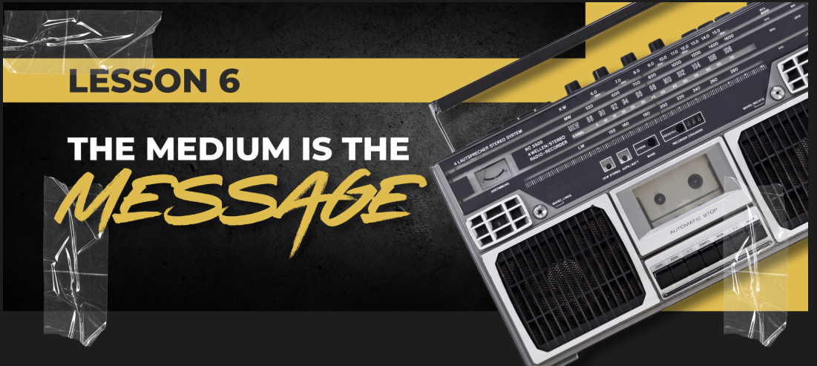

Slide 2
The Four-One-One
This is when things get real. We’re going to dive into the more technical aspects of starting or growing a business. To balance out the cut-and-dry, we’ll also be dissecting the creative aspects of a business including branding and storytelling.

Slide 3
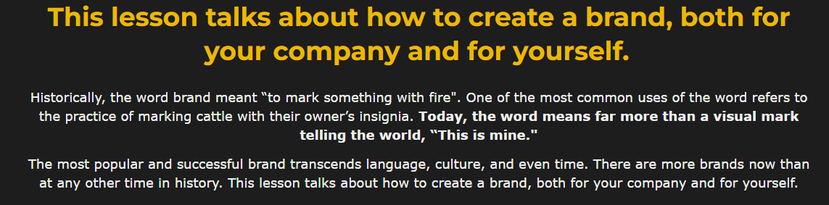

Slide 4


Slide 5
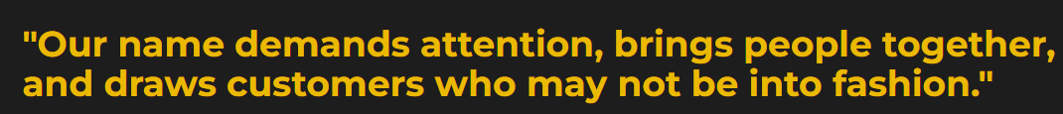
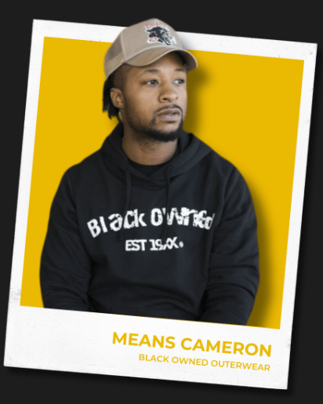
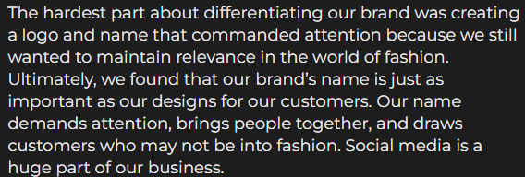
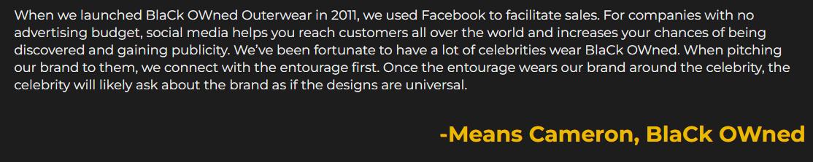

Slide 6


Slide 7
Survey
Before we go any further:
What does the word “brand” mean to you? How would you describe your brand? What have you done to build your brand? How would someone else depict your brand?
Submit your assignment
You may only submit one file with maximum 100 MB in size

Slide 8
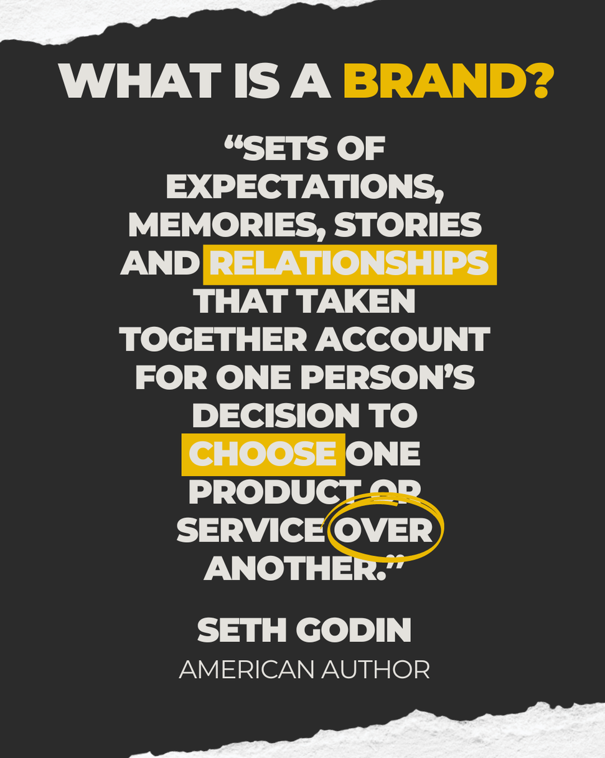

Slide 9
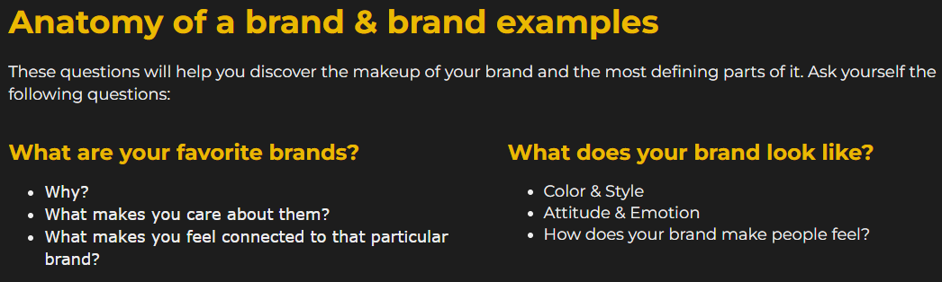


Slide 10
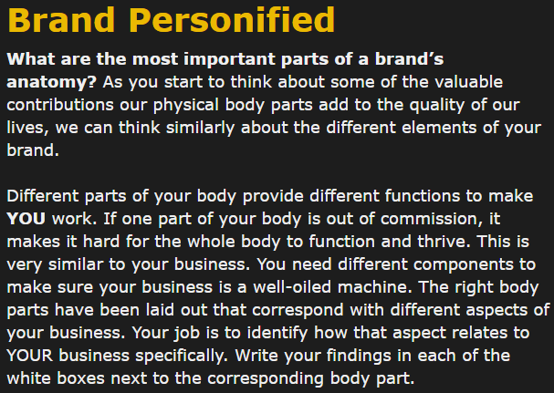
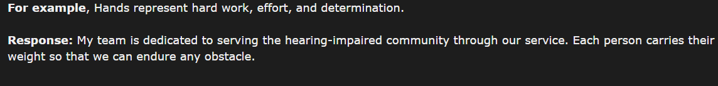

Slide 11
Survey
Brand Personified
What are the most important parts of a brand’s anatomy? As you start to think about some of the valuable contributions our physical body parts add to the quality of our lives, we can think similarly about the different elements of your brand.
Different parts of your body provide different functions to make YOU work. If one part of your body is out of commission, it makes it hard for the whole body to function and thrive. This is very similar to your business. You need different components to make sure your business is a well-oiled machine. The right body parts have been laid out that correspond with different aspects of your business. Your job is to identify how that aspect relates to YOUR business specifically. Write your findings in each of the white boxes next to the corresponding body part.

Slide 12
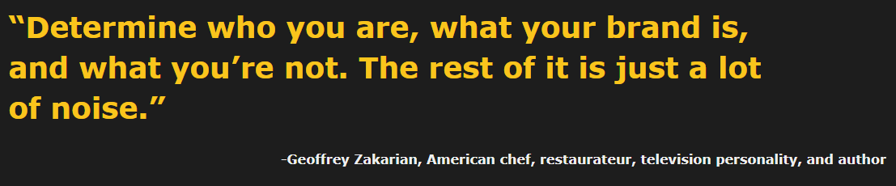

Slide 13
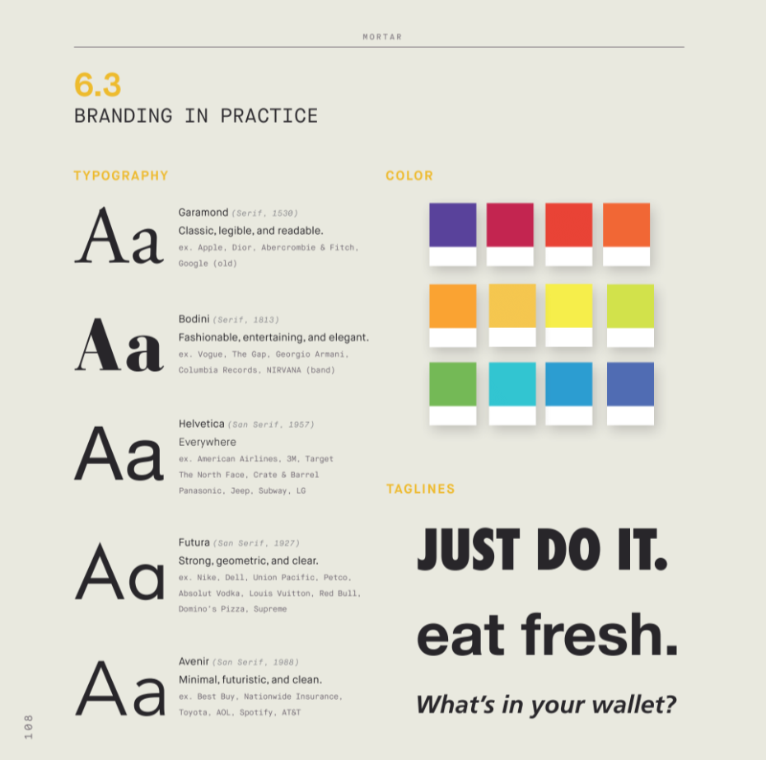

Slide 14
The Studio
Let's watch a video of entrepreneurs describing what branding means to them and how it relates to you AND your business:

Slide 15
Survey
Here are some good questions: What is a brand? What do certain colors and fonts communicate to customers? What makes a good tagline? Write down five things you learned?

Slide 16
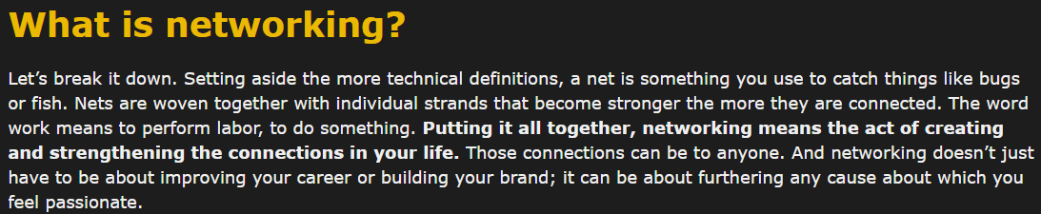
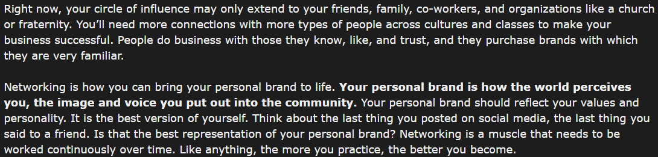

Slide 17
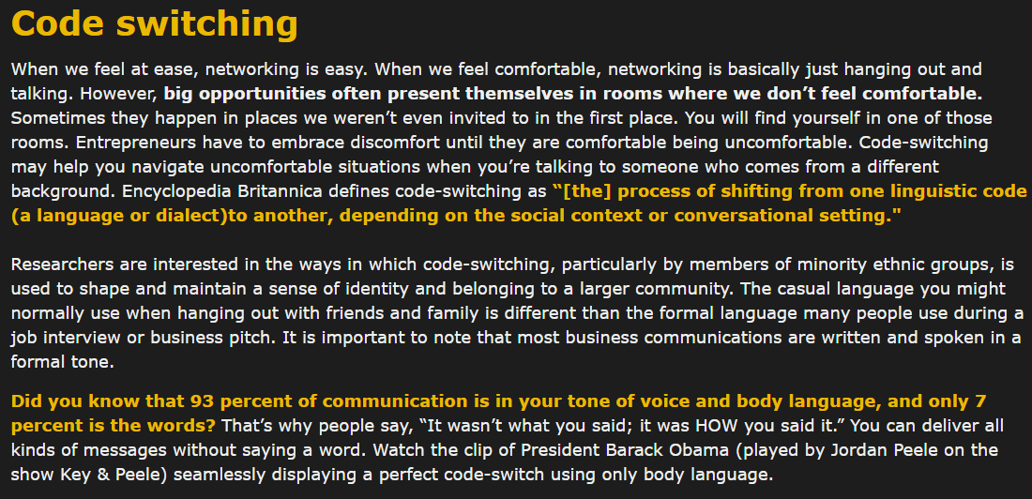

Slide 19
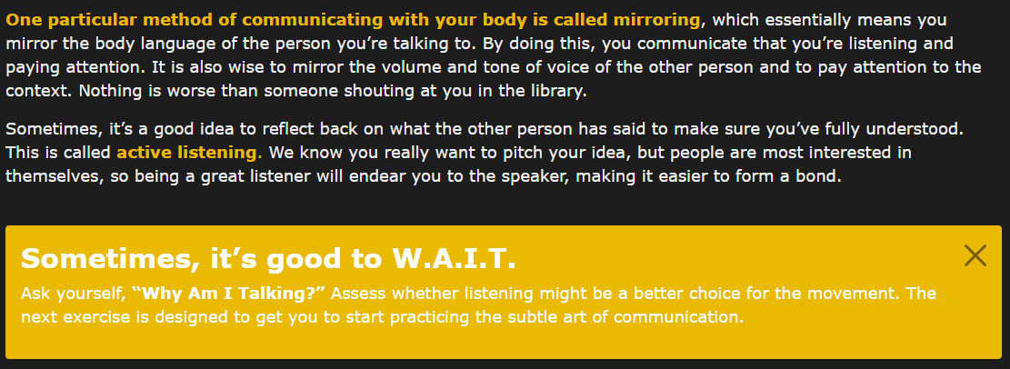

Slide 20
Survey
What does the word “brand” mean to you? How would you describe your brand? What have you done to build your brand? How would someone else depict your brand? Have your answers changed from the beginning of class? Why or why not?
Submit your assignment
You may only submit one file with maximum 100 MB in size

Slide 21
Survey
Putting In Work:
"About Me"
Write the “About Me” section for your future or current social media pages and website.
Submit your assignment
You may only submit one file with maximum 100 MB in size
My Device
Google Drive
Dropbox
OneDrive
Link (URL)
S

Slide 22
Survey
Research
Make a list of every company you can find (5-10 preferably) that provides the same thing that your business(or business idea) provides (or seeks to provide); these companies could potentially be your competition.

Slide 23
Survey
Masters Business Canvas and Synopsis
Go to your business canvas and answer the corresponding questions on sticky notes in the Branding section. Once you’ve done that, type out a paragraph of those responses in your Business Synopsis.
Submit your assignment
You may only submit one file with maximum 100 MB in siz

Slide 24
Survey
Pitches
You’ve almost made it to the halfway point. It’s time to knock out your 100-word pitch. Make sure to include a concise idea about what your business is, who you serve, and how we can contact you. Don’t forget; you can continue to iron out your 40-word pitch!

Slide 25
Quiz
What does Allen Woods define as a “brand” in The Studio panel discussion?
Choose only ONE best answer.
A
A logo or visual representation of a company
B
Your logo and a collection of elements, memories, or emotions that connect you to an entity/company
This answer is correct.
What is mirroring while communicating?
Choose only ONE best answer.
A
Mirroring the body language of the person you’re talking to
B
Talking to yourself in the mirror
This answer is correct A
How does Ray Ball recommend approaching networking in The Studio panel discussion? Select all that apply.
Choose ALL answers that apply.
A
Only attending typical mixer-style networking events.
B
Attending networking events where there are people who are in a position to help you win
C
Being strategic about your time
D
Being aware of potential customers in a non-traditional setting
This answer is correct.
What percentage of communication is your tone of voice and body language?
Choose only ONE best answer.
A
30
B
57
C
74
D
93 - correct

Slide 26
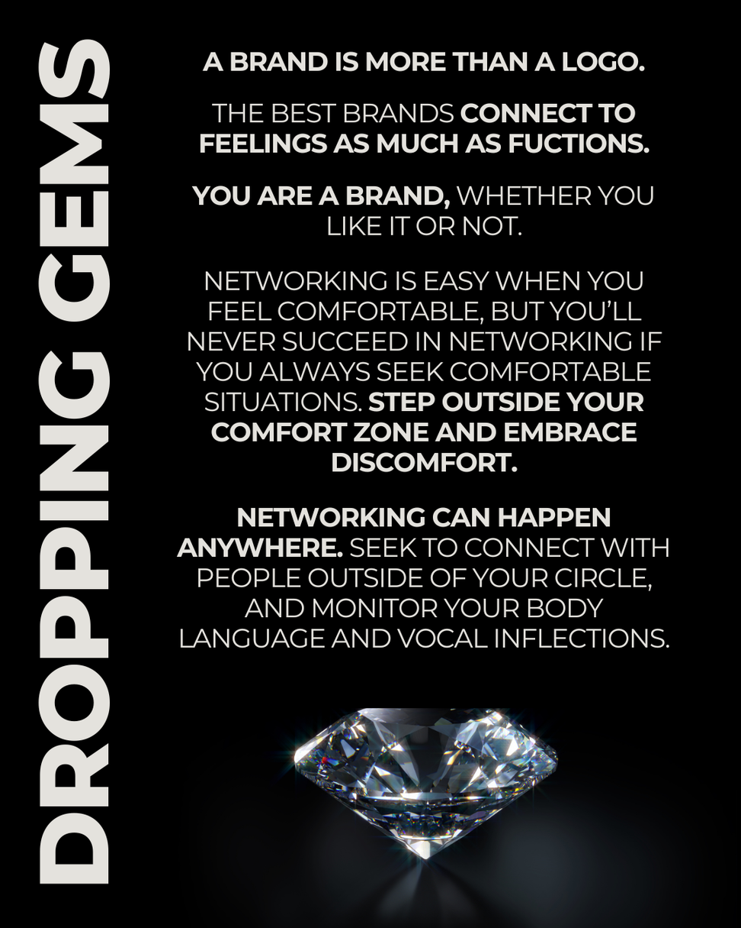

Slide 27
